Slide 1
WELCOME TO MY PRESENTAION PRESENTED BY: TANHA FERDOWS TRAINEE ID: 18 BARCH : IS -10 PROGRAM : EDGE COURESE : IT SUPPORT FOR OFFICE MANAGEMENT
SUBMITTED TO:
MD: FAHMIDUR RAHMAN SAKIB
LECTURER AT DEPARTMENT OF COMPUTER
SCIENCE AND ENGINEERING
METROPOLITAN UNIVERSITY

Slide 2
What is computer hardware
A computer system is made of a combination of hardware and software. The software consists of a set of instructions that instruct the computer to perform a task. It can be system software or application software. Whereas, hardware is the part of a computer that can be touched. In other words, computer hardware consists of the physical components of a computer. The internal parts of a computer are called components and the external hardware components are called peripherals.
Computer hardware consists of the following types of components:
A central processing unit (CPU)/ processor
Storage devices
Input devices
Output devices

Slide 3
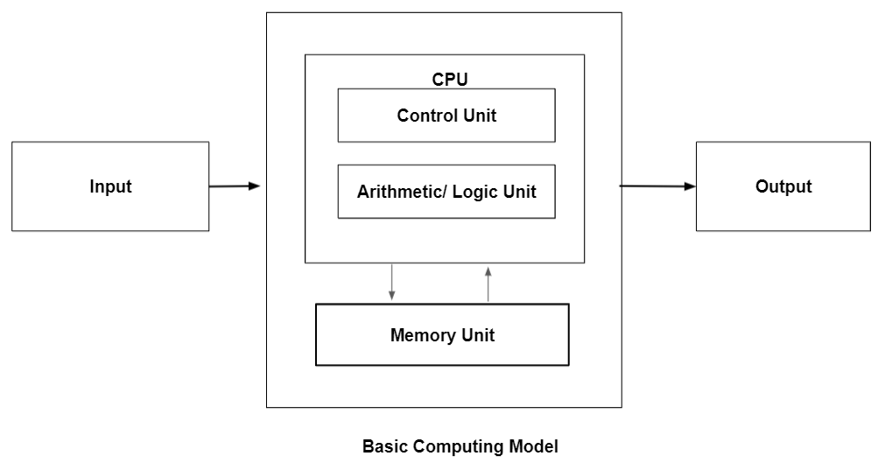
Basic computing model The working of a computer differs from model to model. However, the basic function of every computer remains the same. Below are the four functions that occur in every computer system:

Slide 4
Receiving input: The computer receives information/ data from input devices that is, keyboard or mouse.
Information processing: After receiving the information, the computer processes it by using arithmetic and logical operations.
Display output: Finally, the computer displays the output to the end-user using output devices such as the monitor or printer.
Store information: The computer stores the processed information in storage devices such as hard disks and compact disks.

Slide 5
The Central Processing Unit
The CPU is the central part of the computer. It is the brain of a computer. It handles all the functions such as data processing operations, storing results, and executing instructions. CPU consists of five components: control unit (CU), arithmetic logic unit (ALU), registers, buses, and clock.
Control unit
Arithmetic logic unit
Registers
Buses
Clock

Slide 6
Memory
Memory is the part of the computer, typically a storage area where the computer stores the instructions before and after processing them. The computer memory is divided into smaller parts or blocks. Each part represents a unique address and the range of these addresses depends on the size of the memory. Computer memory is broadly classified into two types: primary memory and secondary memory.
Primary Memory
Random-access memory (RAM)
Read-only memory (ROM)
Secondary Memory
Floppy disks: Floppy disks are small, flexible storage devices made of plastic and coated with magnetic material. They can be single-sided or double-sided. The data on the floppy disk is recorded in the form of magnetized particles.
Hard disk/ hard drive: Hard disk drives are removable magnetic disks. They hold more data than floppy disks and are faster.
Optical disk drives: It is a disk drive that reads and writes data using laser light or electromagnetic waves.
Compact disks: Compact disks are pre-pressed optical compact disks that consist of data. They can read data but not write or erase data.
USB: A USB (USB flash drive) or pen drive is a portable device that reads and writes data using the USB port in computers. They are compact and easy to carry.

Slide 7
Input devices
Below are examples of the commonly used input devices:
Keyboard: Keyboard is the most popular form of input device used to input data to a computer system. It consists of keys as numeric keys, alphabet keys, function keys, special character keys, and non-printable control keys.
Mouse: A mouse is a pointing device that controls the navigation of the cursor on the computer screen. It is a tiny device that is rolled using hands and placed on a flat surface. The cursor on the screen moves as per the direction of the mouse. A mouse can be wired or wireless.
Joystick: Joystick is a pointing device that controls the cursor position on the PC screen. It looks like a stick and has a ball with lower and upper ends. A joystick is mainly used in computer-aided designing and playing games.
Scanner: A scanner is used to transfer information from paper to the computer system. It scans the printed material and converts it into a specific file format.

Slide 8
Output devices
Some of the commonly used output devices include:
Monitor or visual display unit (VDU): A monitor is the main output device in a computer. It creates images using dots (pixels) arranged in rectangular form. Monitors can be monochrome or colorful.
Printer: Printers are used to print information on paper. There are several types of printers such as daisy wheel printer, inkjet printer, dot matrix printer, and drum printer.
Speakers: Speakers are output devices that produce audio in the form of sound waves. They can be wired or wireless.
Plotter: Plotters are used to print high-quality images, graphics, and drawings. The common types of plotters are flatbed plotters, drum plotters, and inkjet plotters.

Slide 9
THANKS

